Slide 1
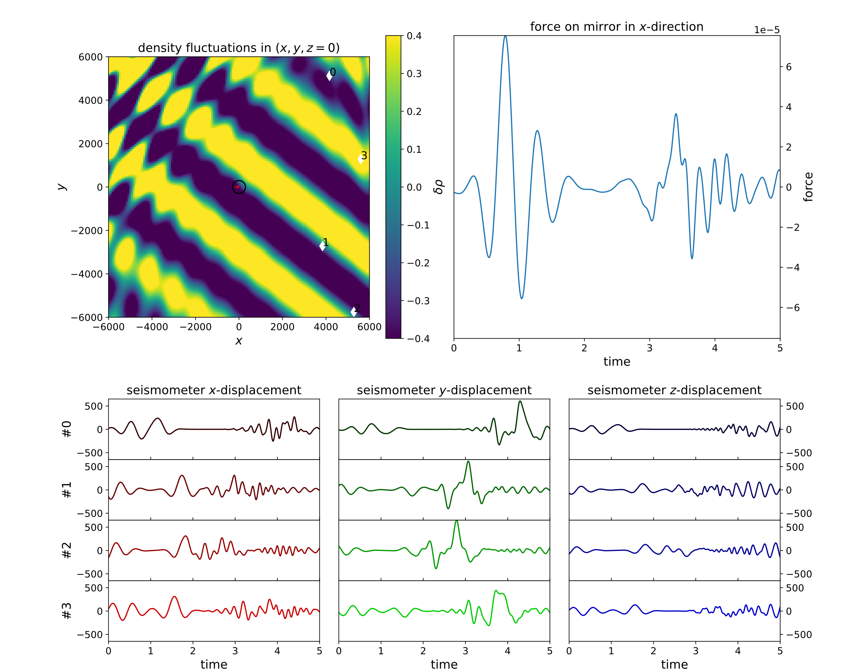
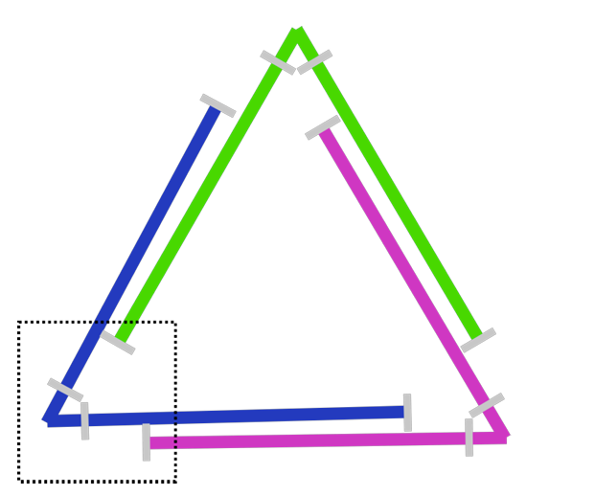
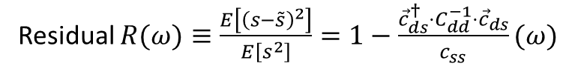
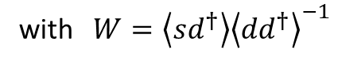
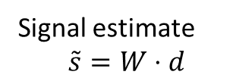
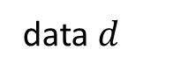
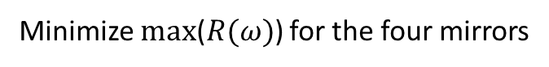
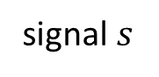
One Mirror: F. Badaracco & J. Harms, arXiv:1903.07936
Wiener Filter
Joint Corner: F. Badaracco et al., arXiv:2310.05709
signal $s$
Signal estimate
$$\tilde{s}=W⋅d$$
with $W=\left\langle sd^{†}\right\rangle {\left\langle dd^{†}\right\rangle }^{−1}$
Residual $R(ω)≡\frac{E\left[{\left(s−\tilde{s}\right)}^{2}\right]}{E\left[s^{2}\right]}=1−\frac{{\vec{c}}_{ds}^{†}⋅C_{dd}^{−1}⋅{\vec{c}}_{ds}}{c_{ss}}(ω)$
Fabry-Perot-Cavity
Joint Corner
Assumptions: homogeniety, isotropy, plain waves
data $d$
Minimize max($R(ω)$) for the four mirrors

Slide 2
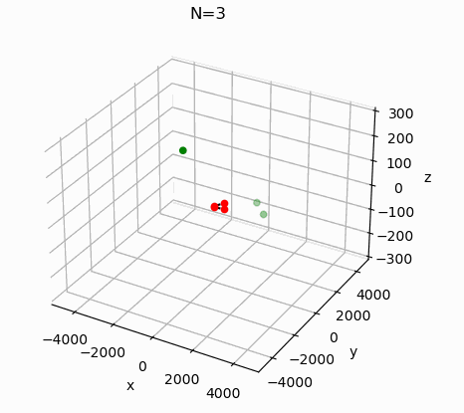
Optimization Algorithm
Original Code: Francesca Badaracco et al., arXiv:2310.05709
→Particle Swarm Optimization
Problem parameters:
Number of Seismometers N (15)
Signal-to-Noise-Ratio of operating seismometers SNR (15)
Optimization frequency f (1 Hz)
Ratio of P- and S-waves p (0.2)

Slide 3
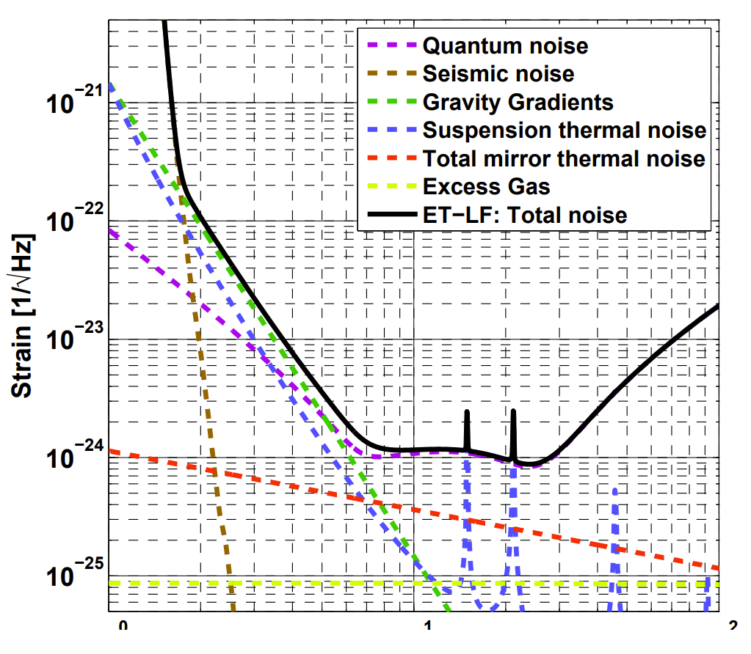
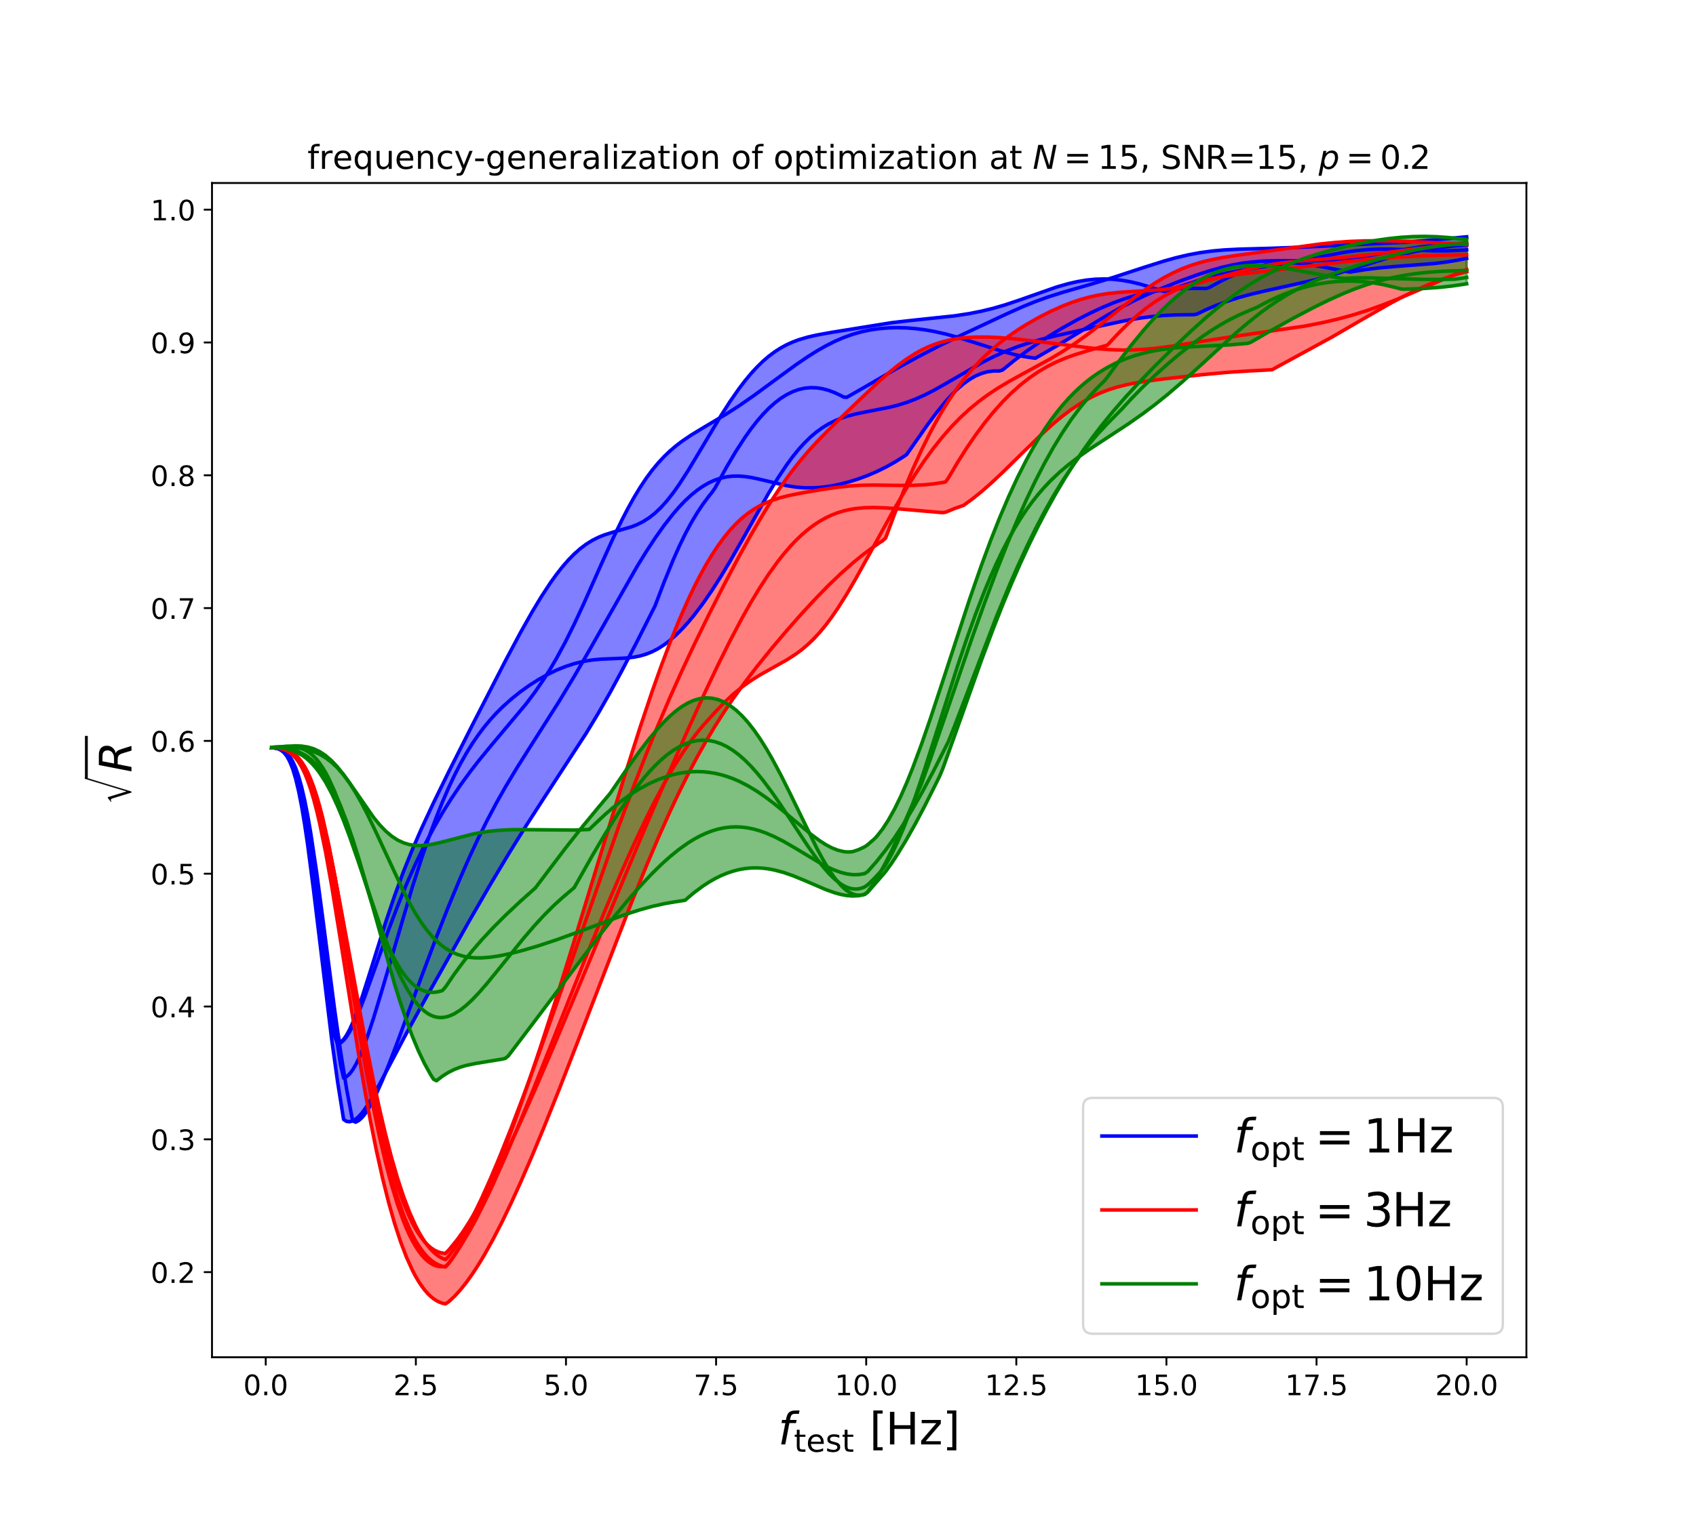
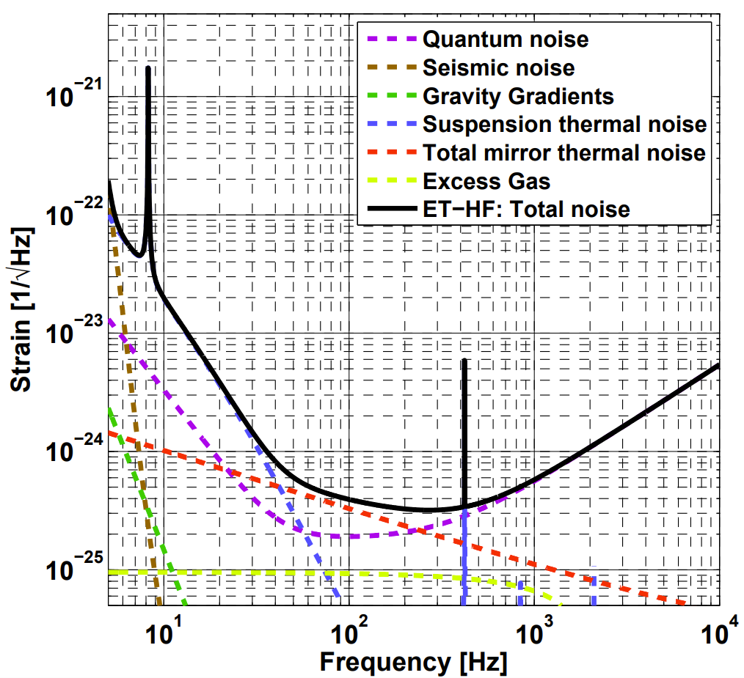
Frequency dependency
Best frequency generalization: 3 Hz

Slide 4
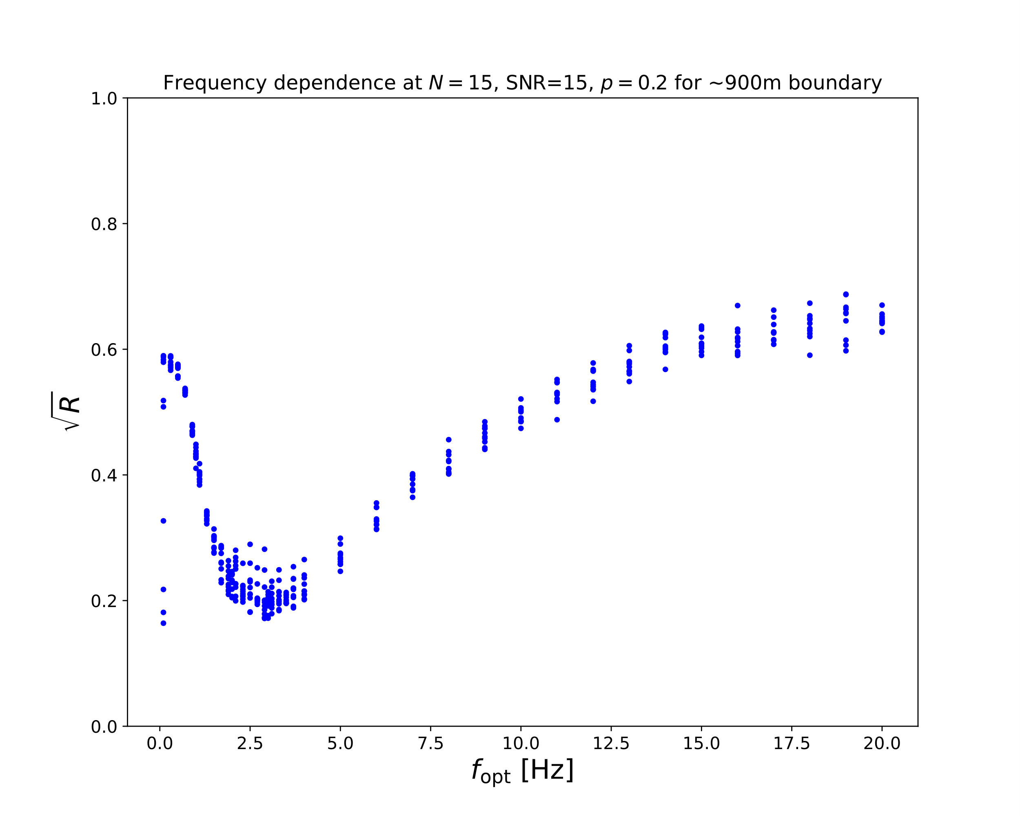
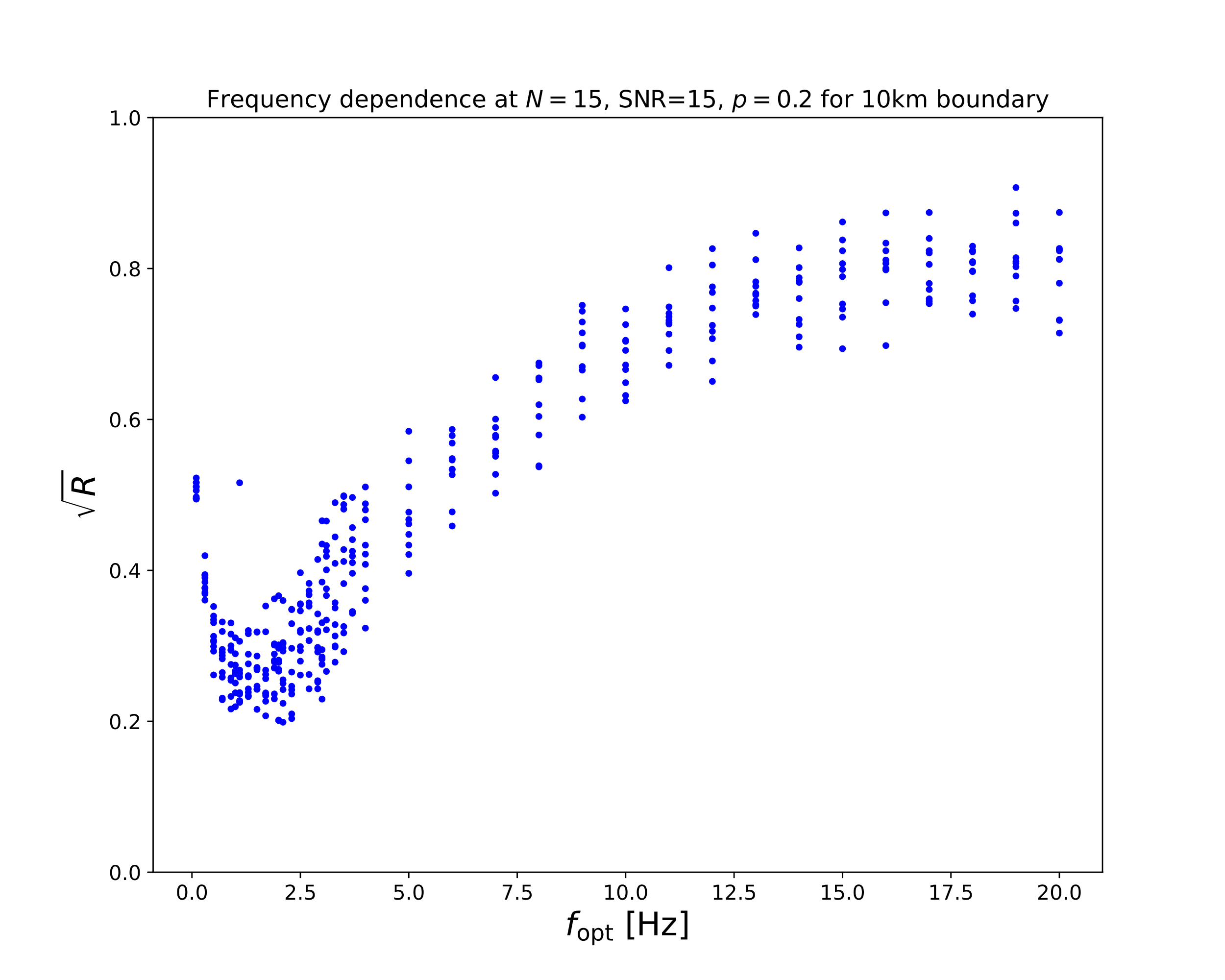
Boundary Dependency
Seismometers need space to predict low frequency Newtonian Noise

Slide 5
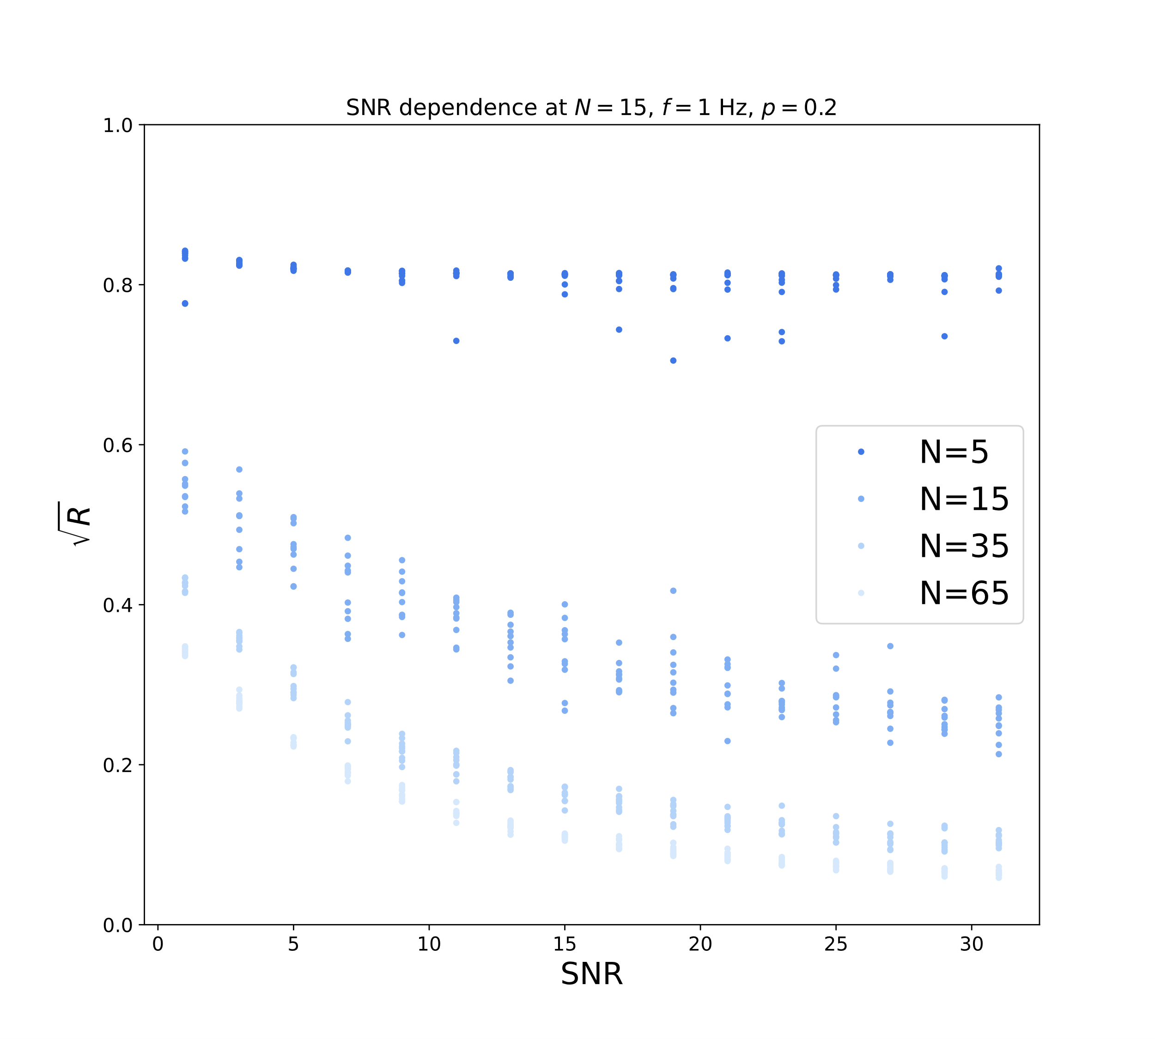
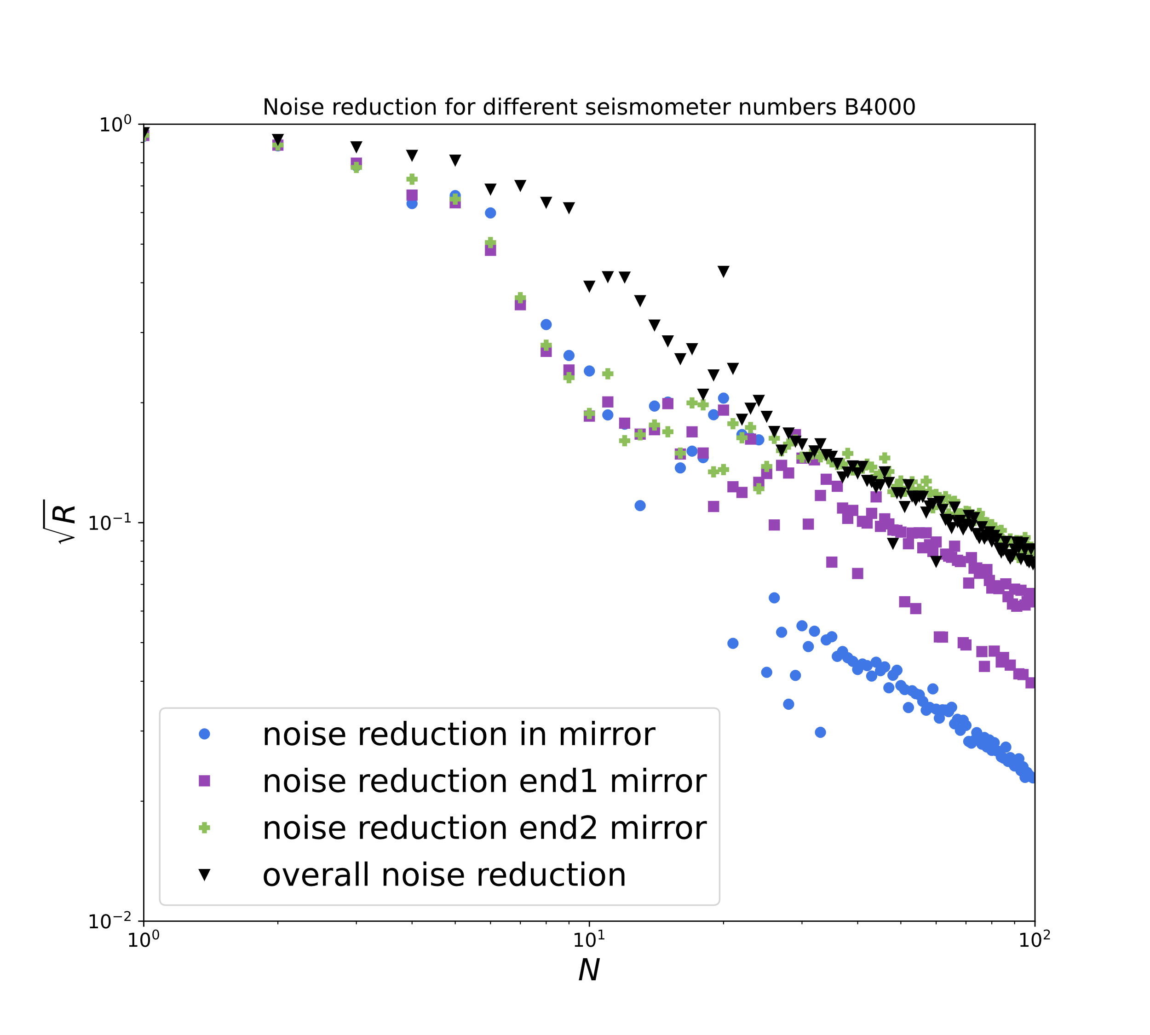
SNR and number dependency
end2 +
4x4x4 grid
5000m 500m
in ●
end1 ■
90%

Slide 6
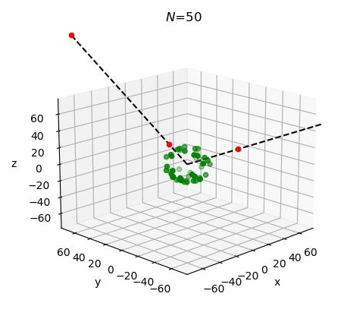
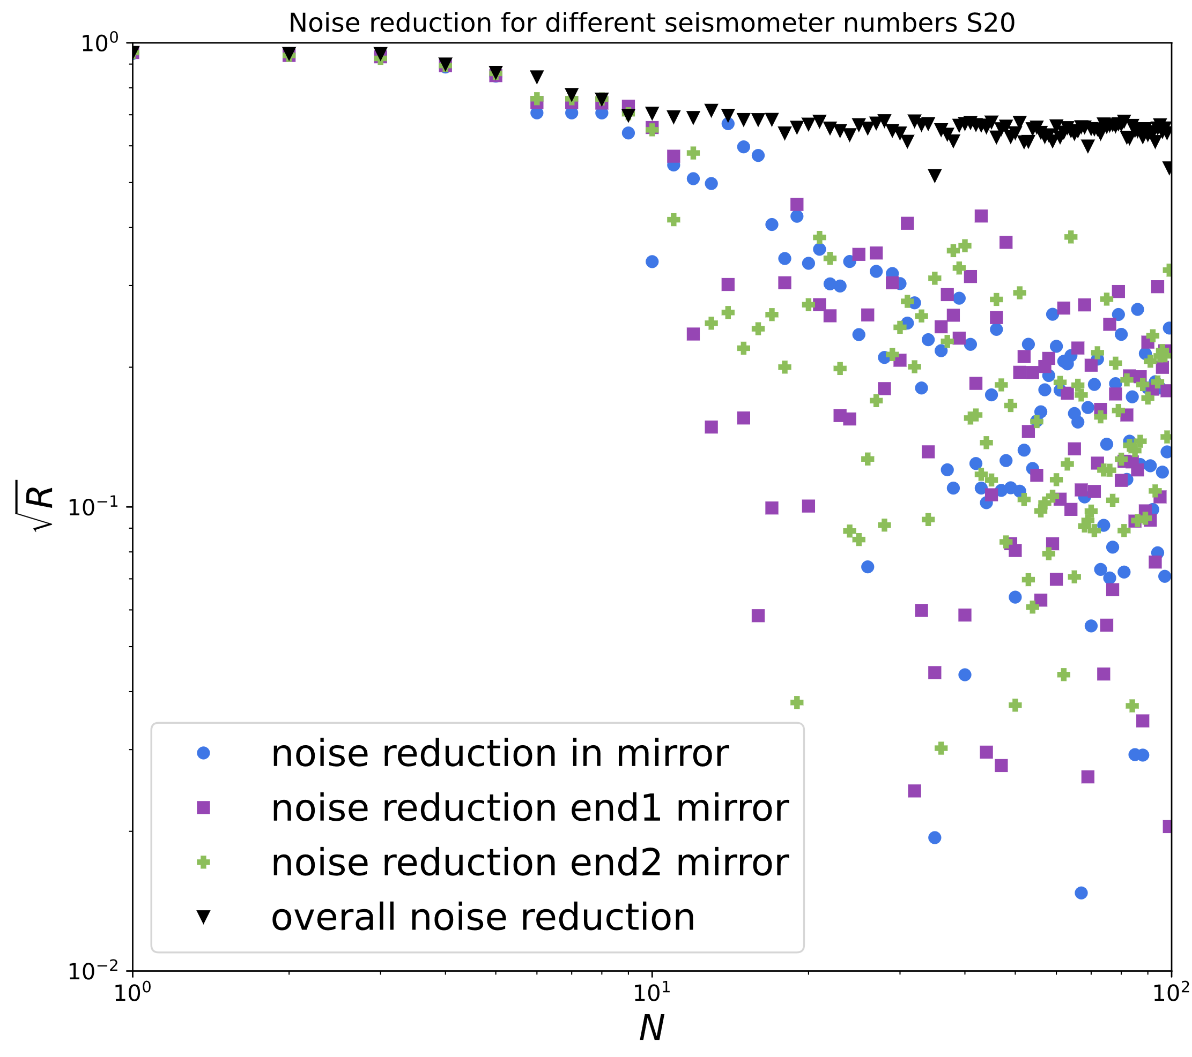
Spherical Cavern
end2 +
spherical grid
in ●
end1 ■
30%
Censored

Slide 7
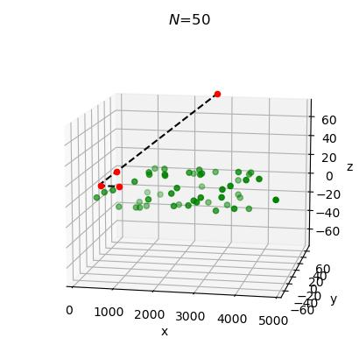
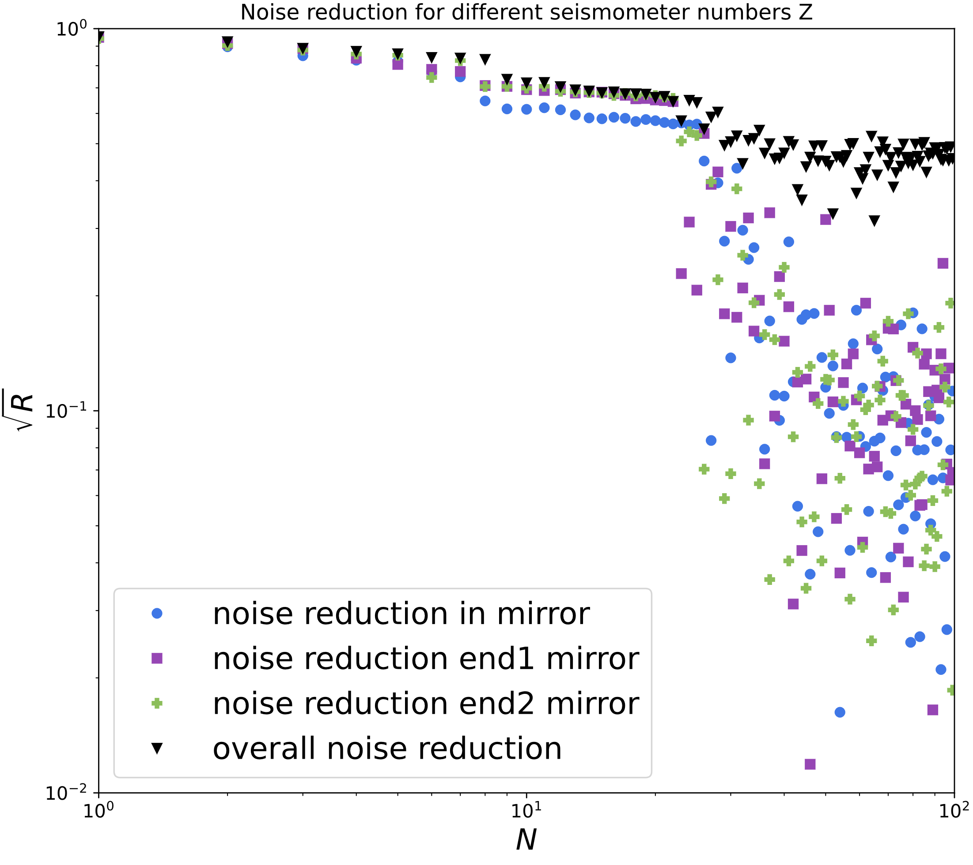
Cylindrical Cavern
end2 +
in ●
end1 ■
40%
Censored

Slide 8
Conclusions and Outlook
Successful Seismometer optimization in (N, SNR, f, p)-space
Reduction by 90%
Cheap in-cavern optimization with already 30% - 40% reduction
Plane-waves → wave packages
Isotropy → realistic arrival directions
Homogeniety → realistic geological model

Slide 9
Backup

Slide 10
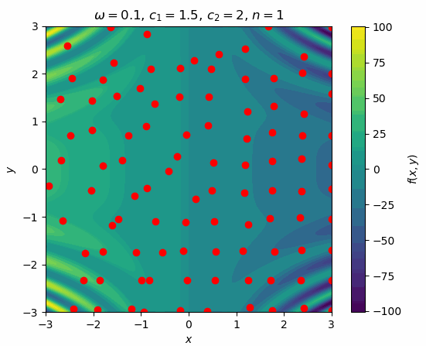
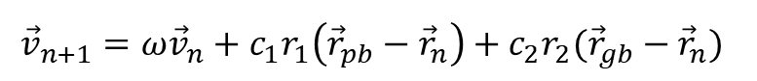
Particle Swarm Optimization
For each particle:
$${\vec{v}}_{n+1}=ω{\vec{v}}_{n}+c_{1}r_{1}\left({\vec{r}}_{pb}−{\vec{r}}_{n}\right)+c_{2}r_{2}({\vec{r}}_{gb}−{\vec{r}}_{n})$$
Quick!
Works in high dimensions
No need for differentiability
Finds good optima?
Idea: J. Kennedy & R. Eberhart, Particle swarm optimization (1995)

Slide 11
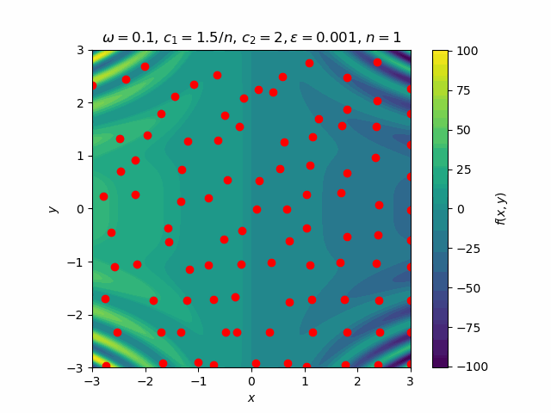
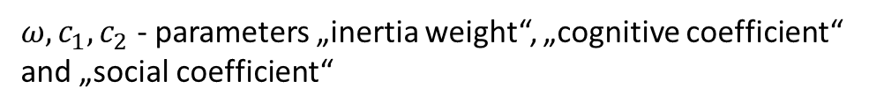
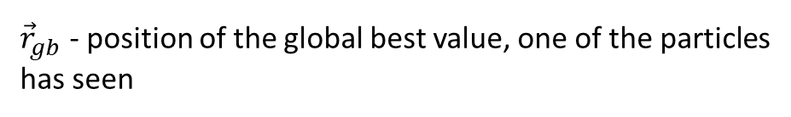
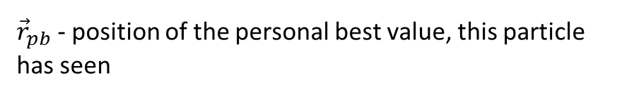
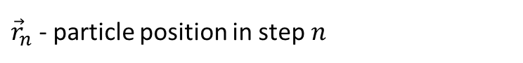
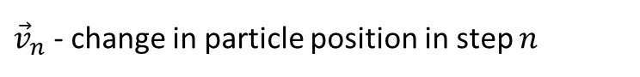
Particle Swarm Optimization
For each particle:
$${\vec{v}}_{n+1}=ω{\vec{v}}_{n}+c_{1}r_{1}\left({\vec{r}}_{pb}−{\vec{r}}_{n}\right)+c_{2}r_{2}({\vec{r}}_{gb}−{\vec{r}}_{n})$$
${\vec{v}}_{n}$ - change in particle position in step $n$
${\vec{r}}_{n}$ - particle position in step $n$
${\vec{r}}_{pb}$ - position of the personal best value, this particle has seen
${\vec{r}}_{gb}$ - position of the global best value, one of the particles has seen
$ω, c_{1},c_{2}$ - parameters „inertia weight“, „cognitive coefficient“ and „social coefficient“
$r_{1},{ r}_{2}$ - random numbers $∈[0,1]$

Slide 12
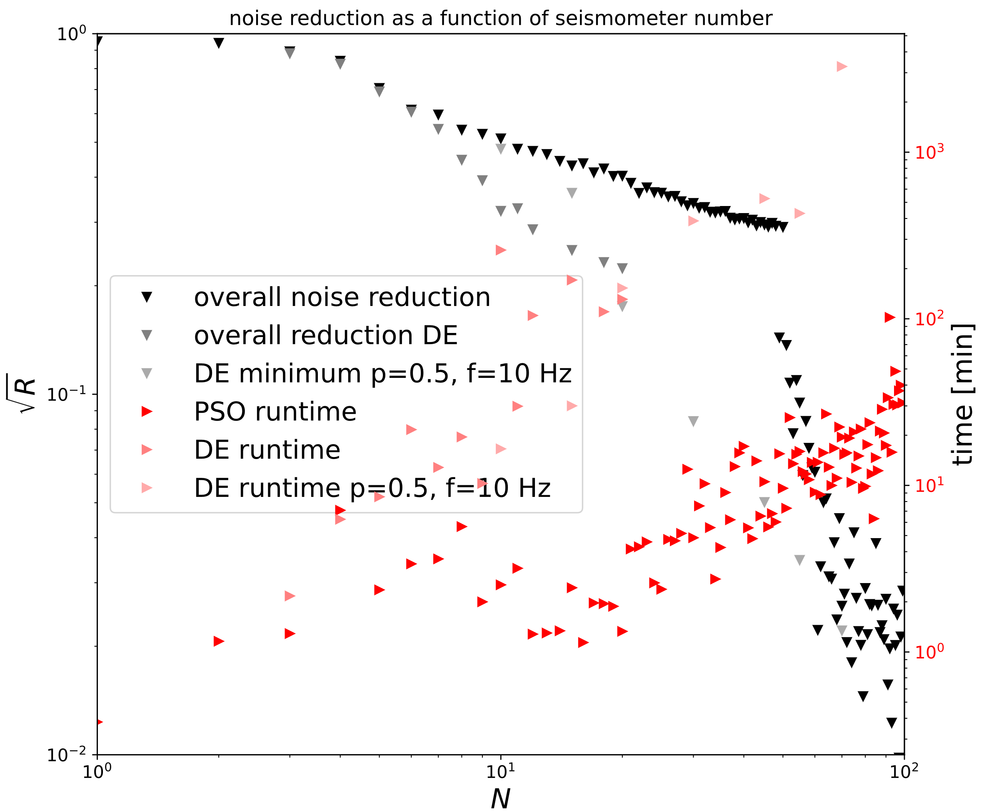
Optimization Time

Slide 13
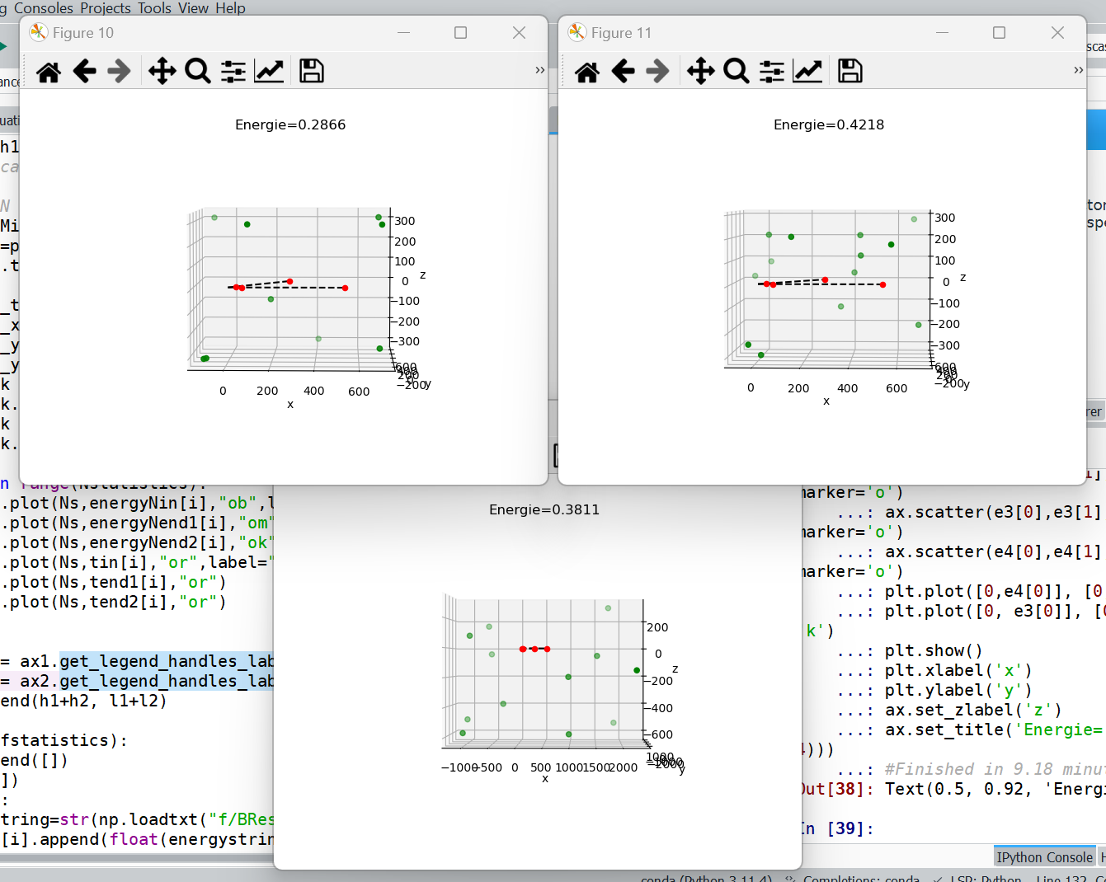
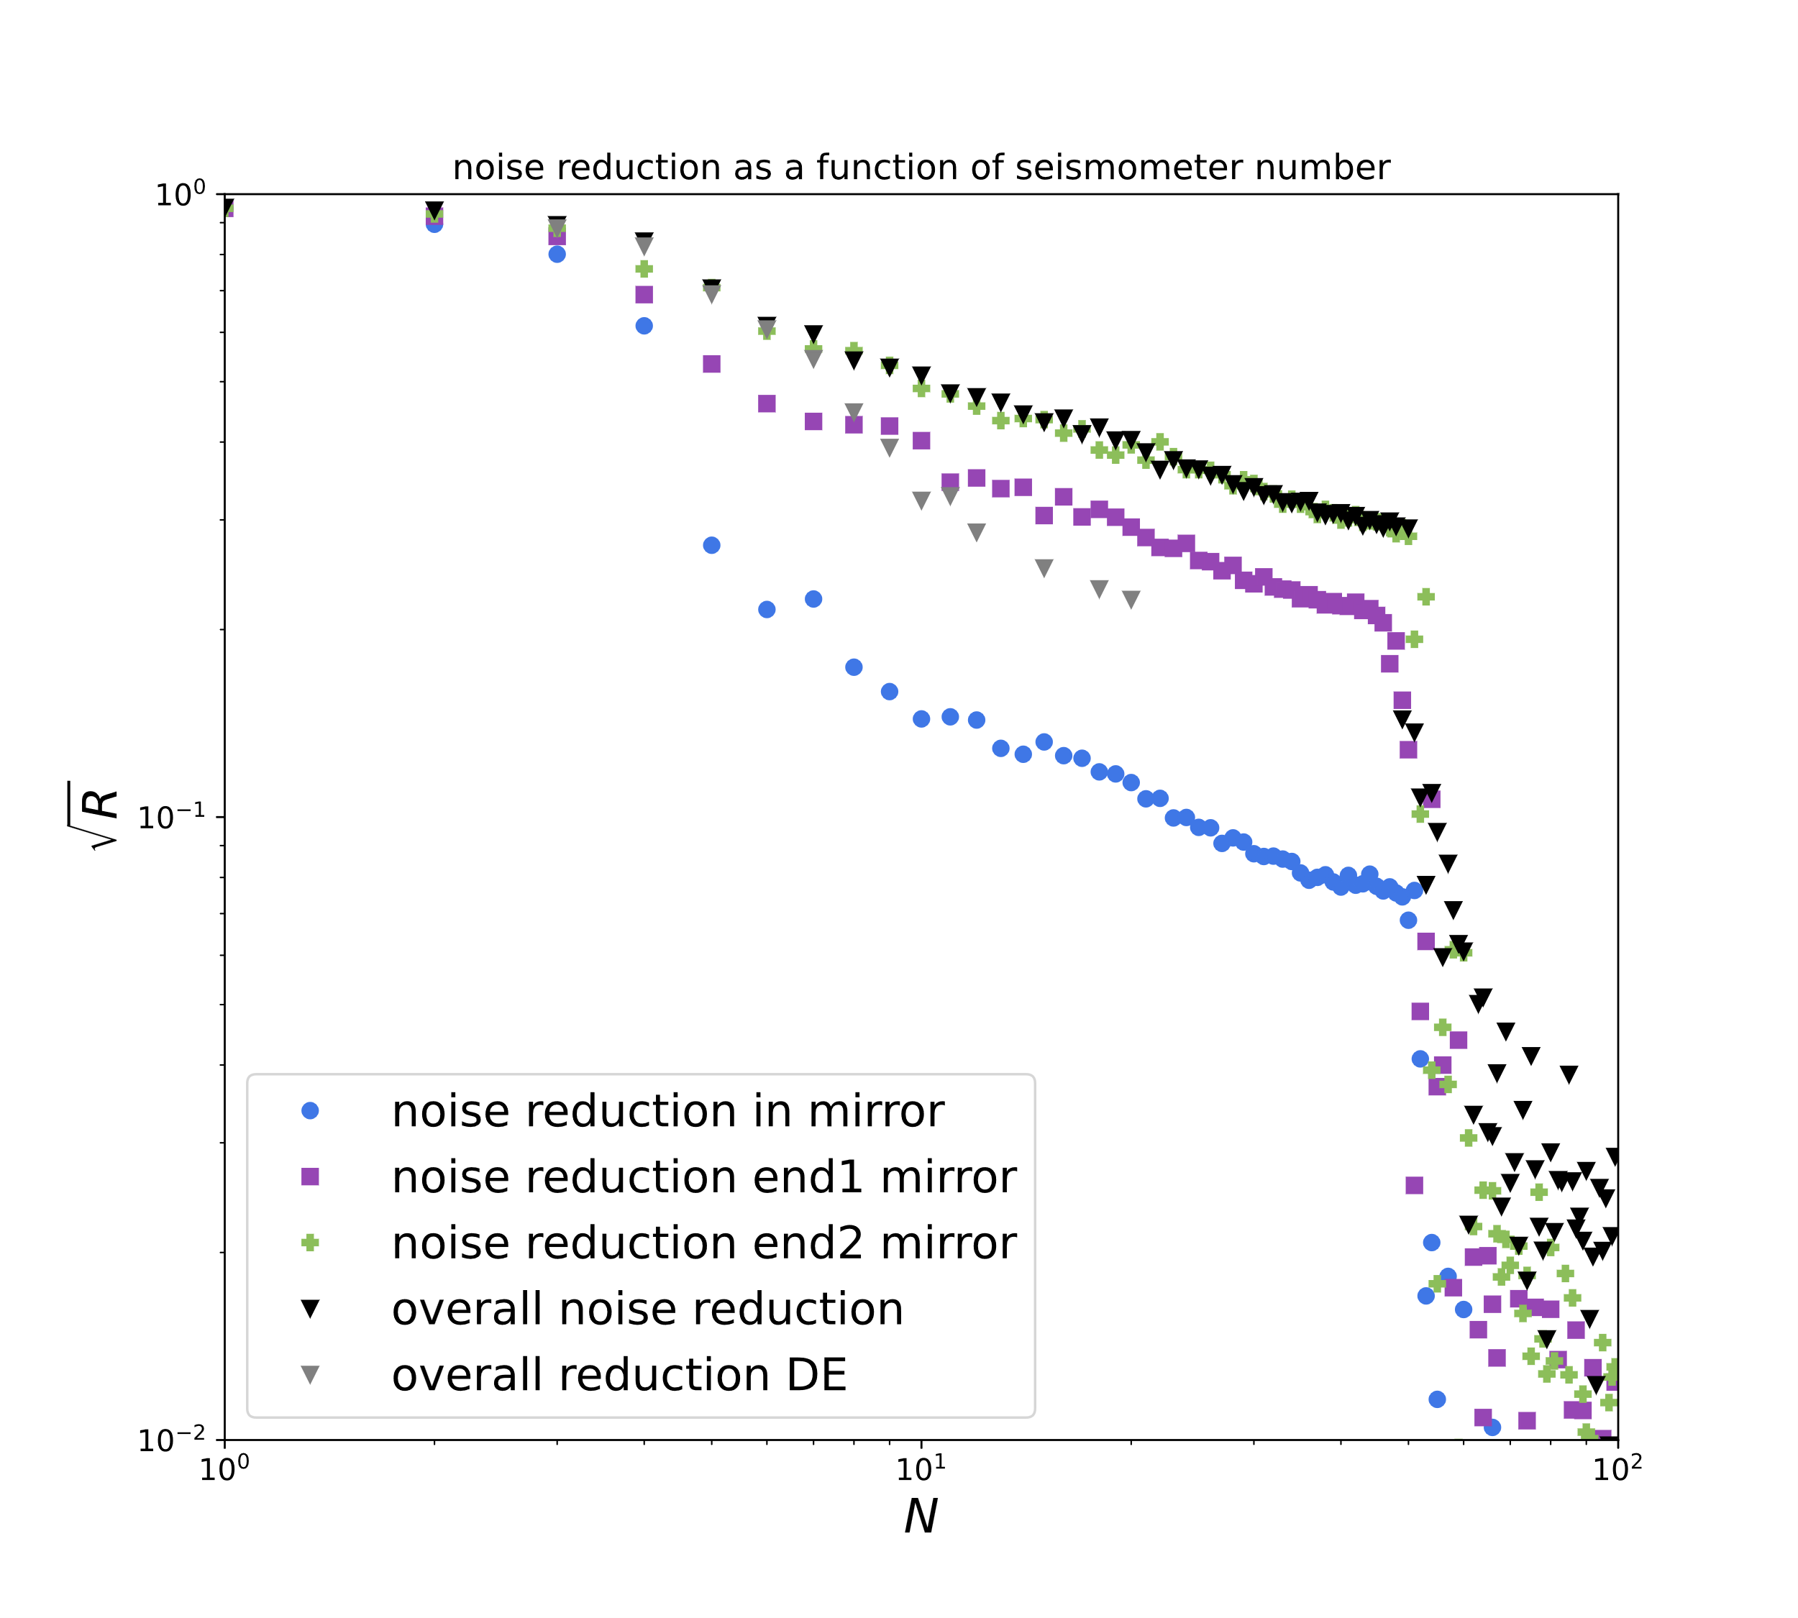
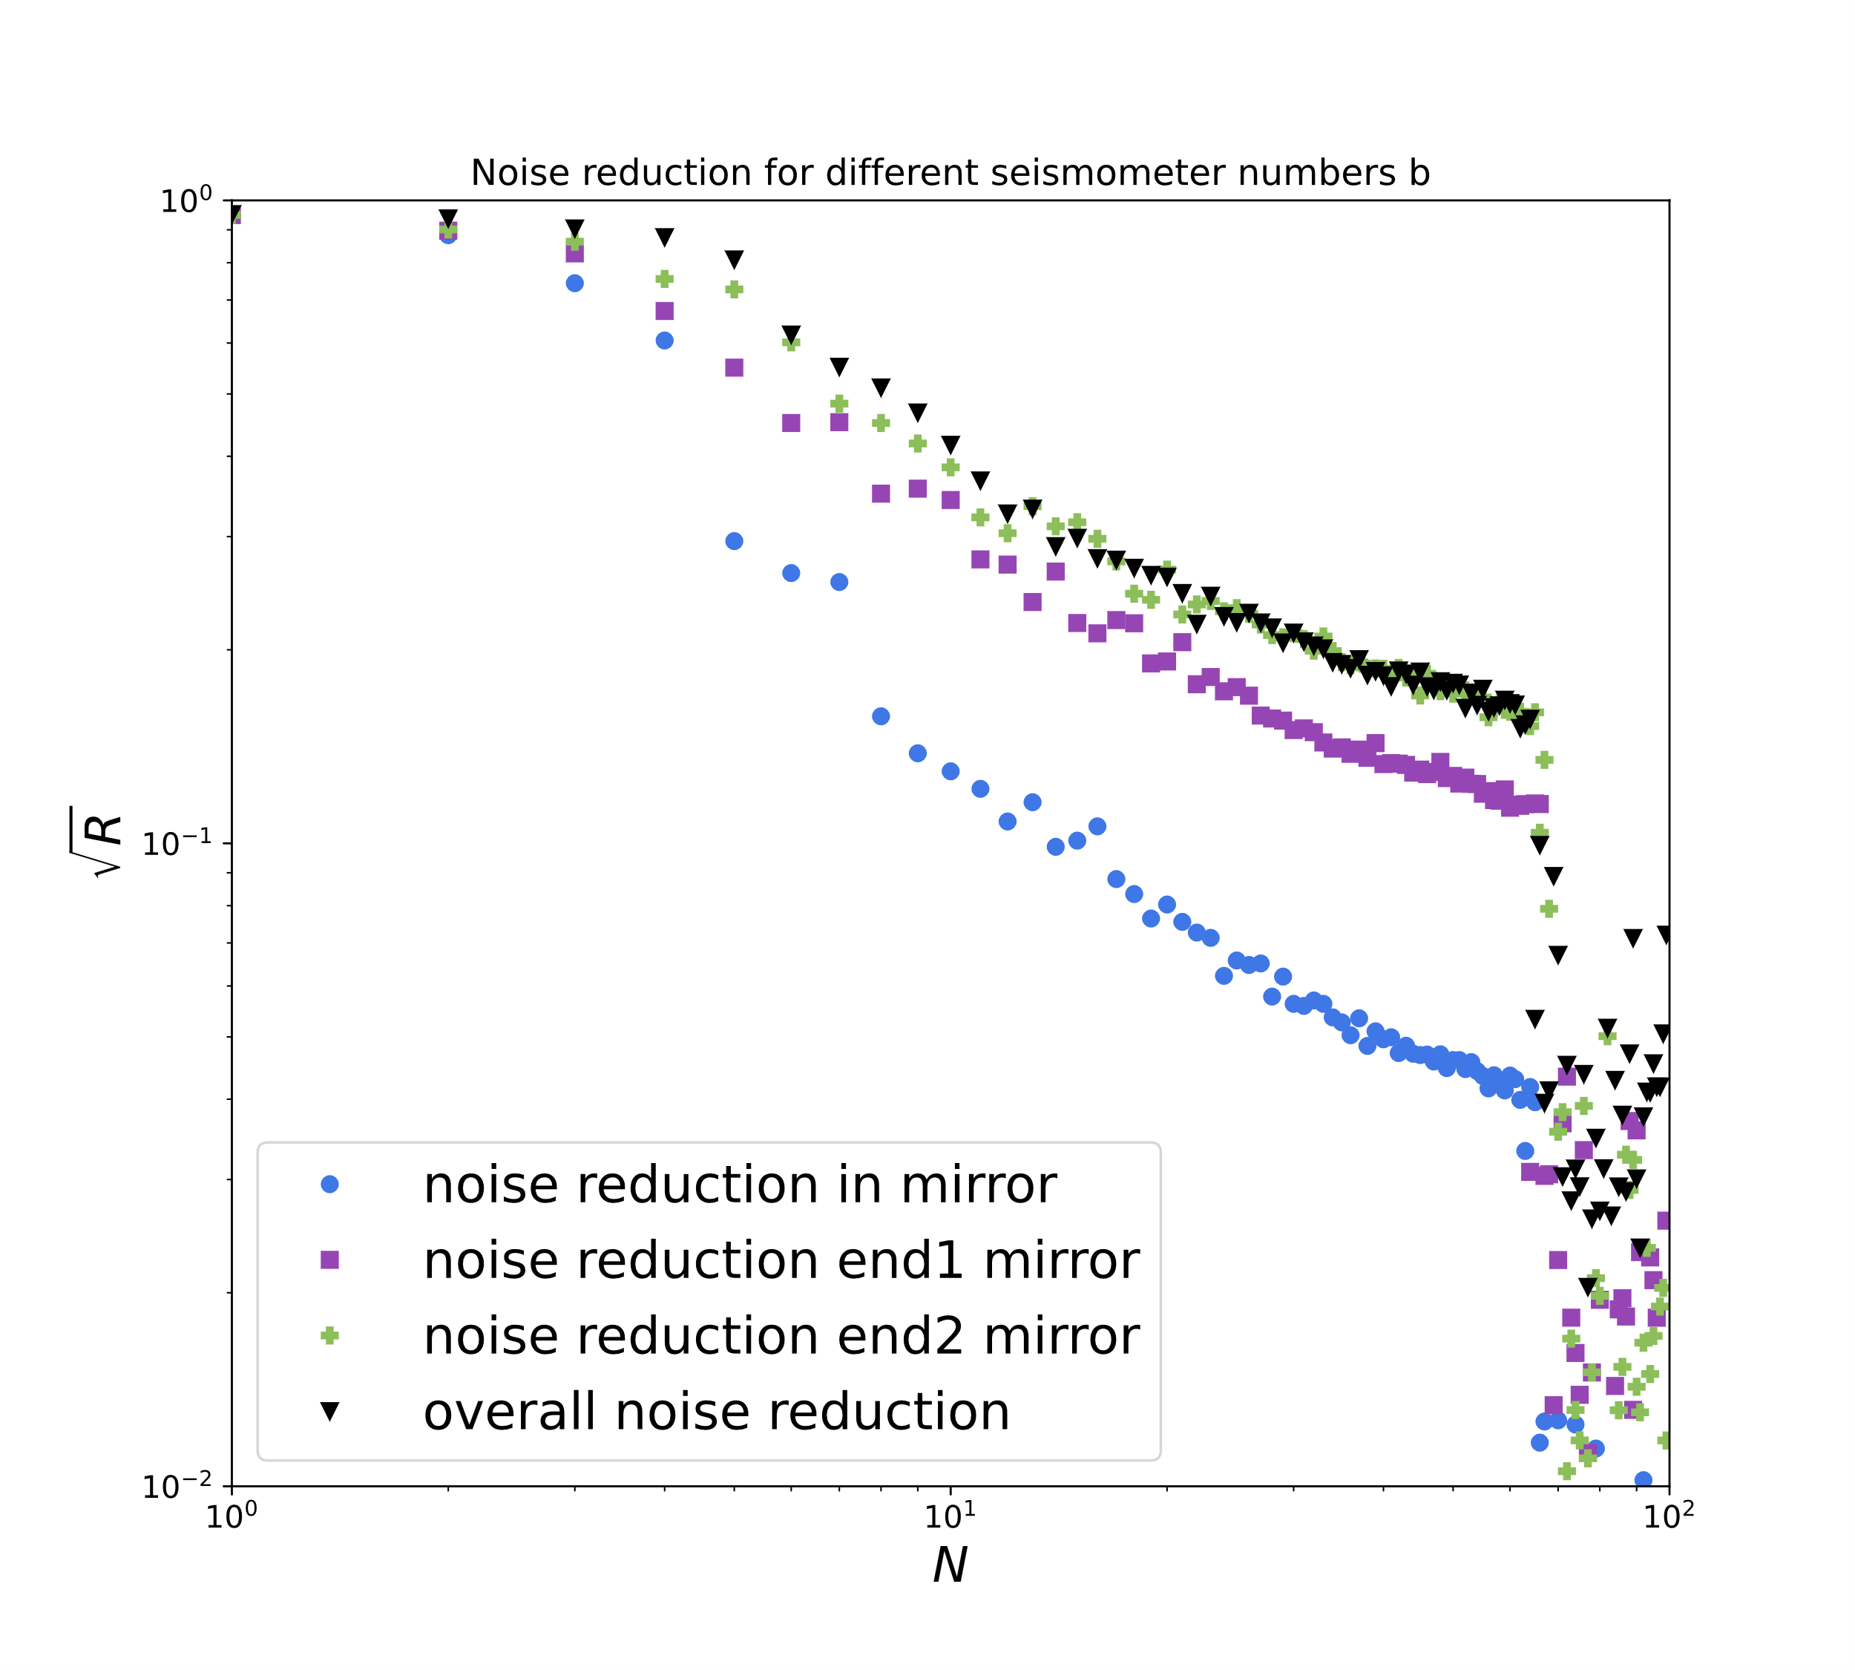
Boundary and PSO
DE
PSO

Slide 14

Uncensored
Sphere
Cylinder

Slide 15
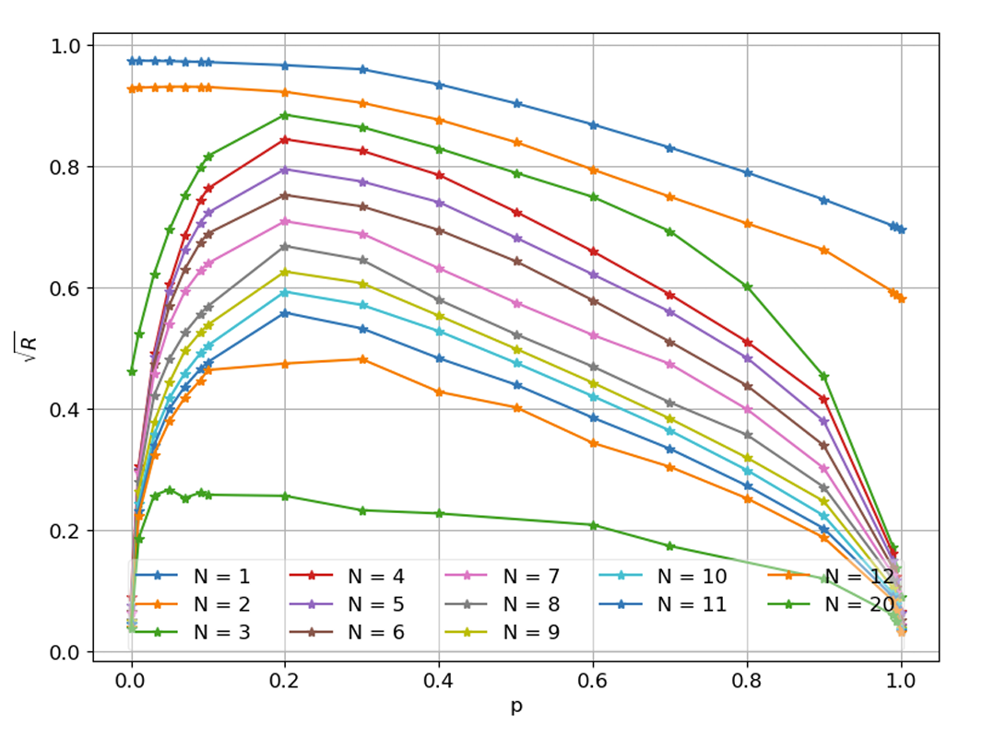
p-dependence
F. Badaracco et al., arXiv:2310.05709

Slide 16
Outlook +
Cost function
Compare optimizations methods
Plane-waves → wave packages
Isotropy → realistic arrival directions
Homogeniety → realistic geological model
Neural Networks
Real-time calculations

